Slide 1
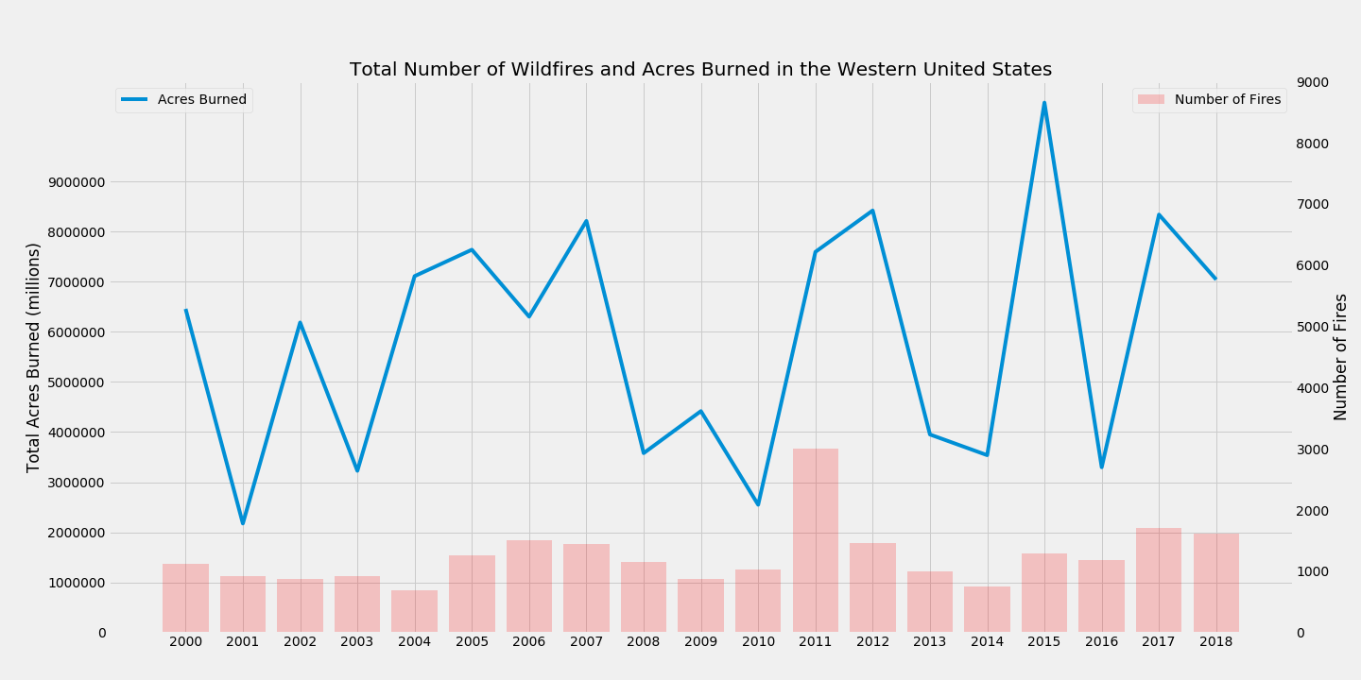
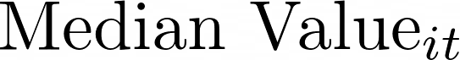
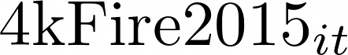
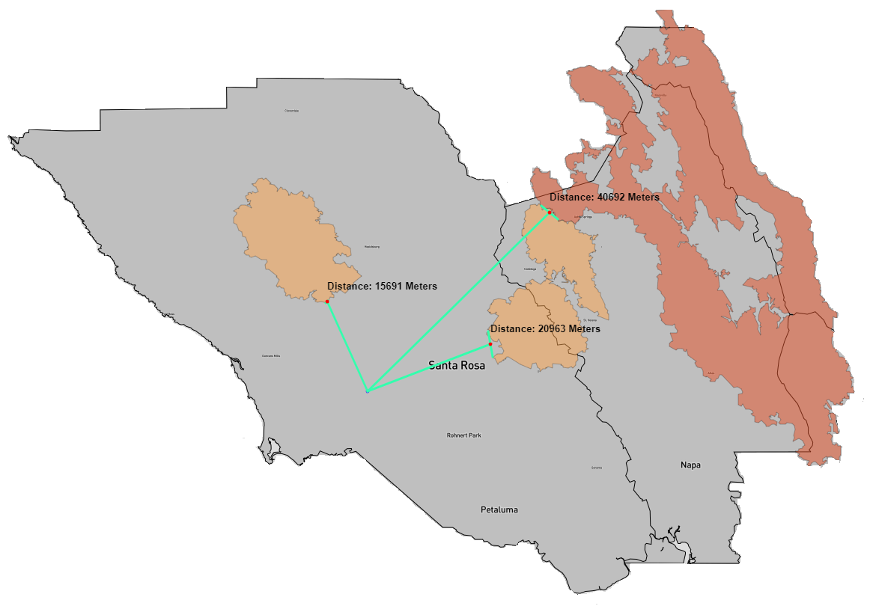
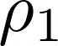
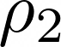
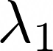
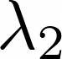
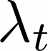
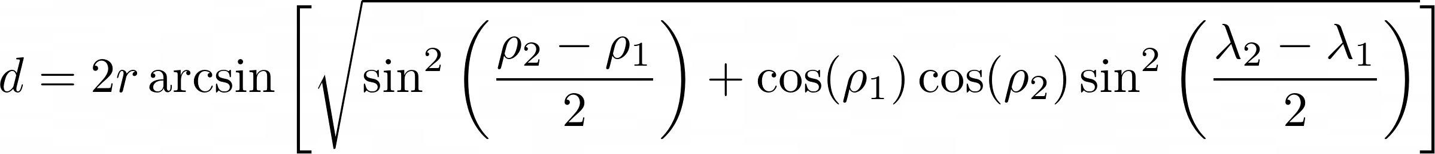
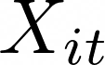
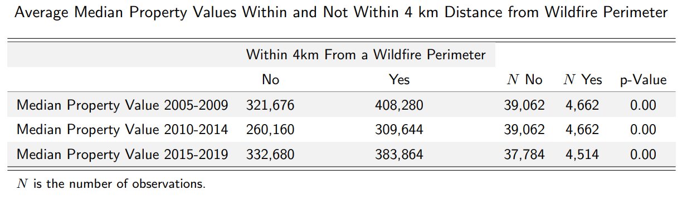
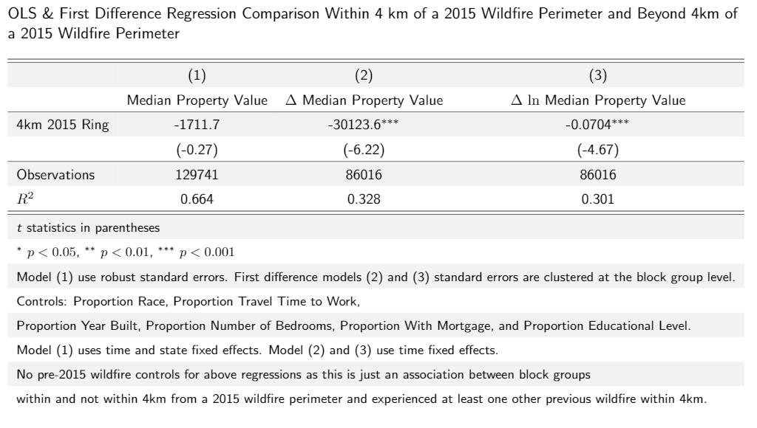
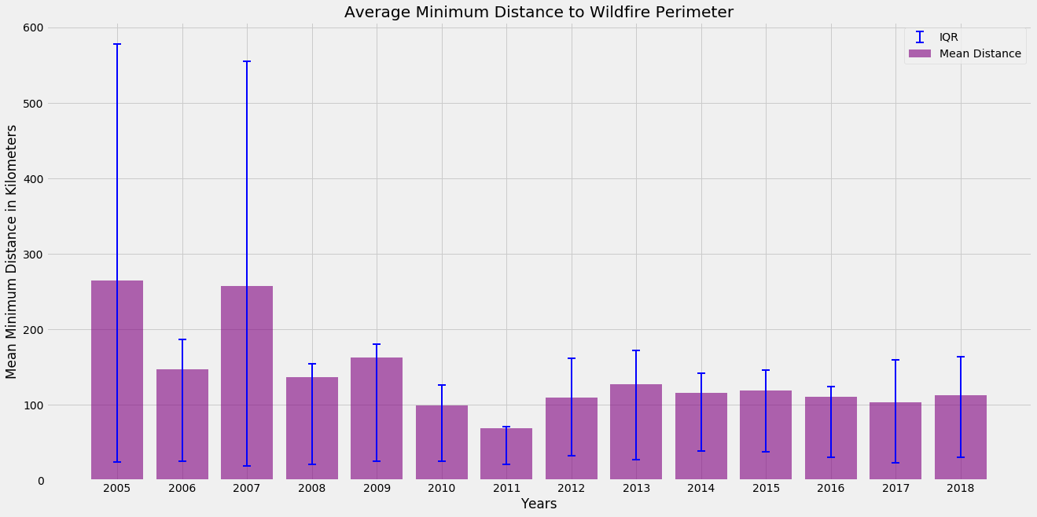
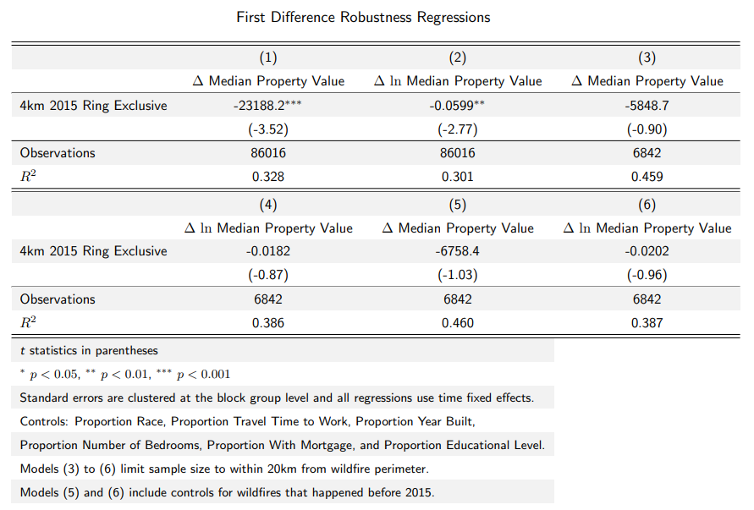
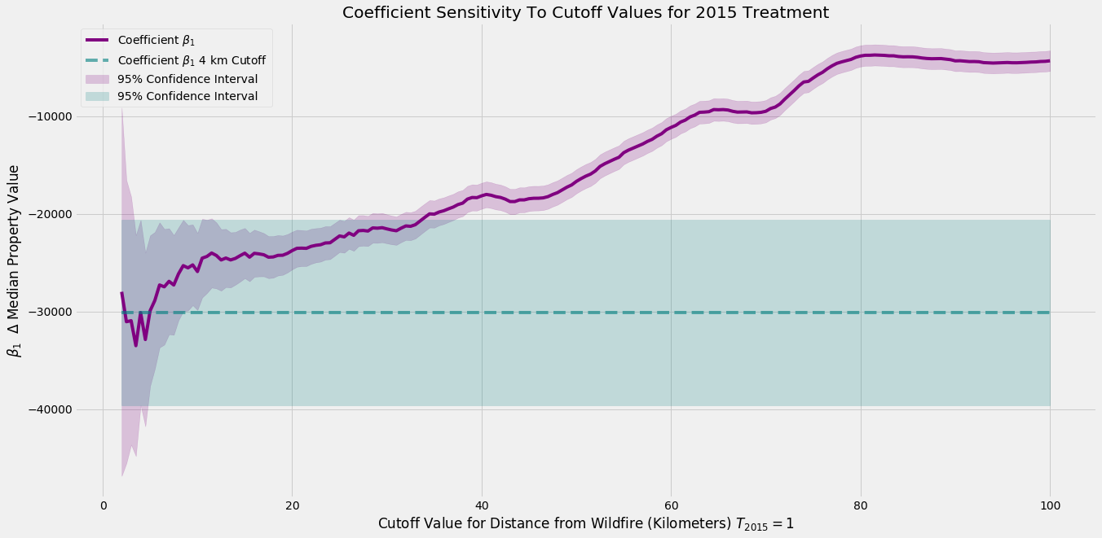
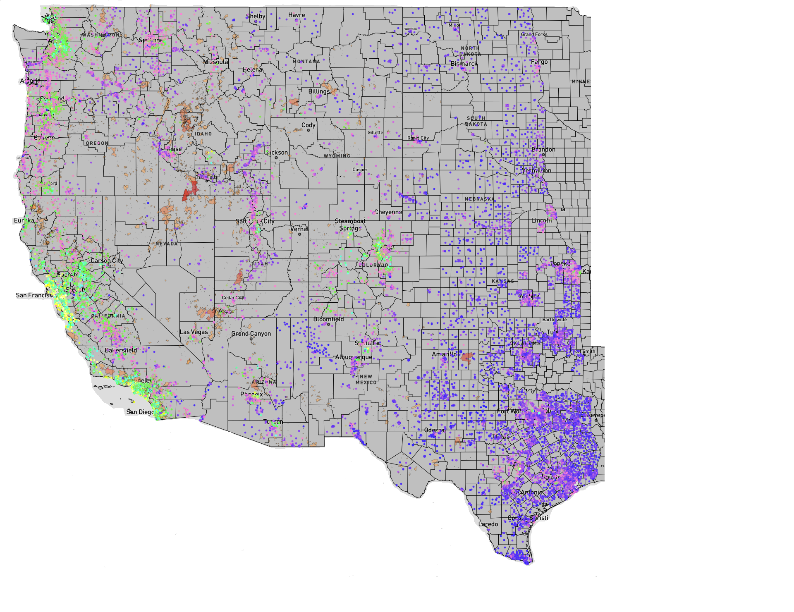
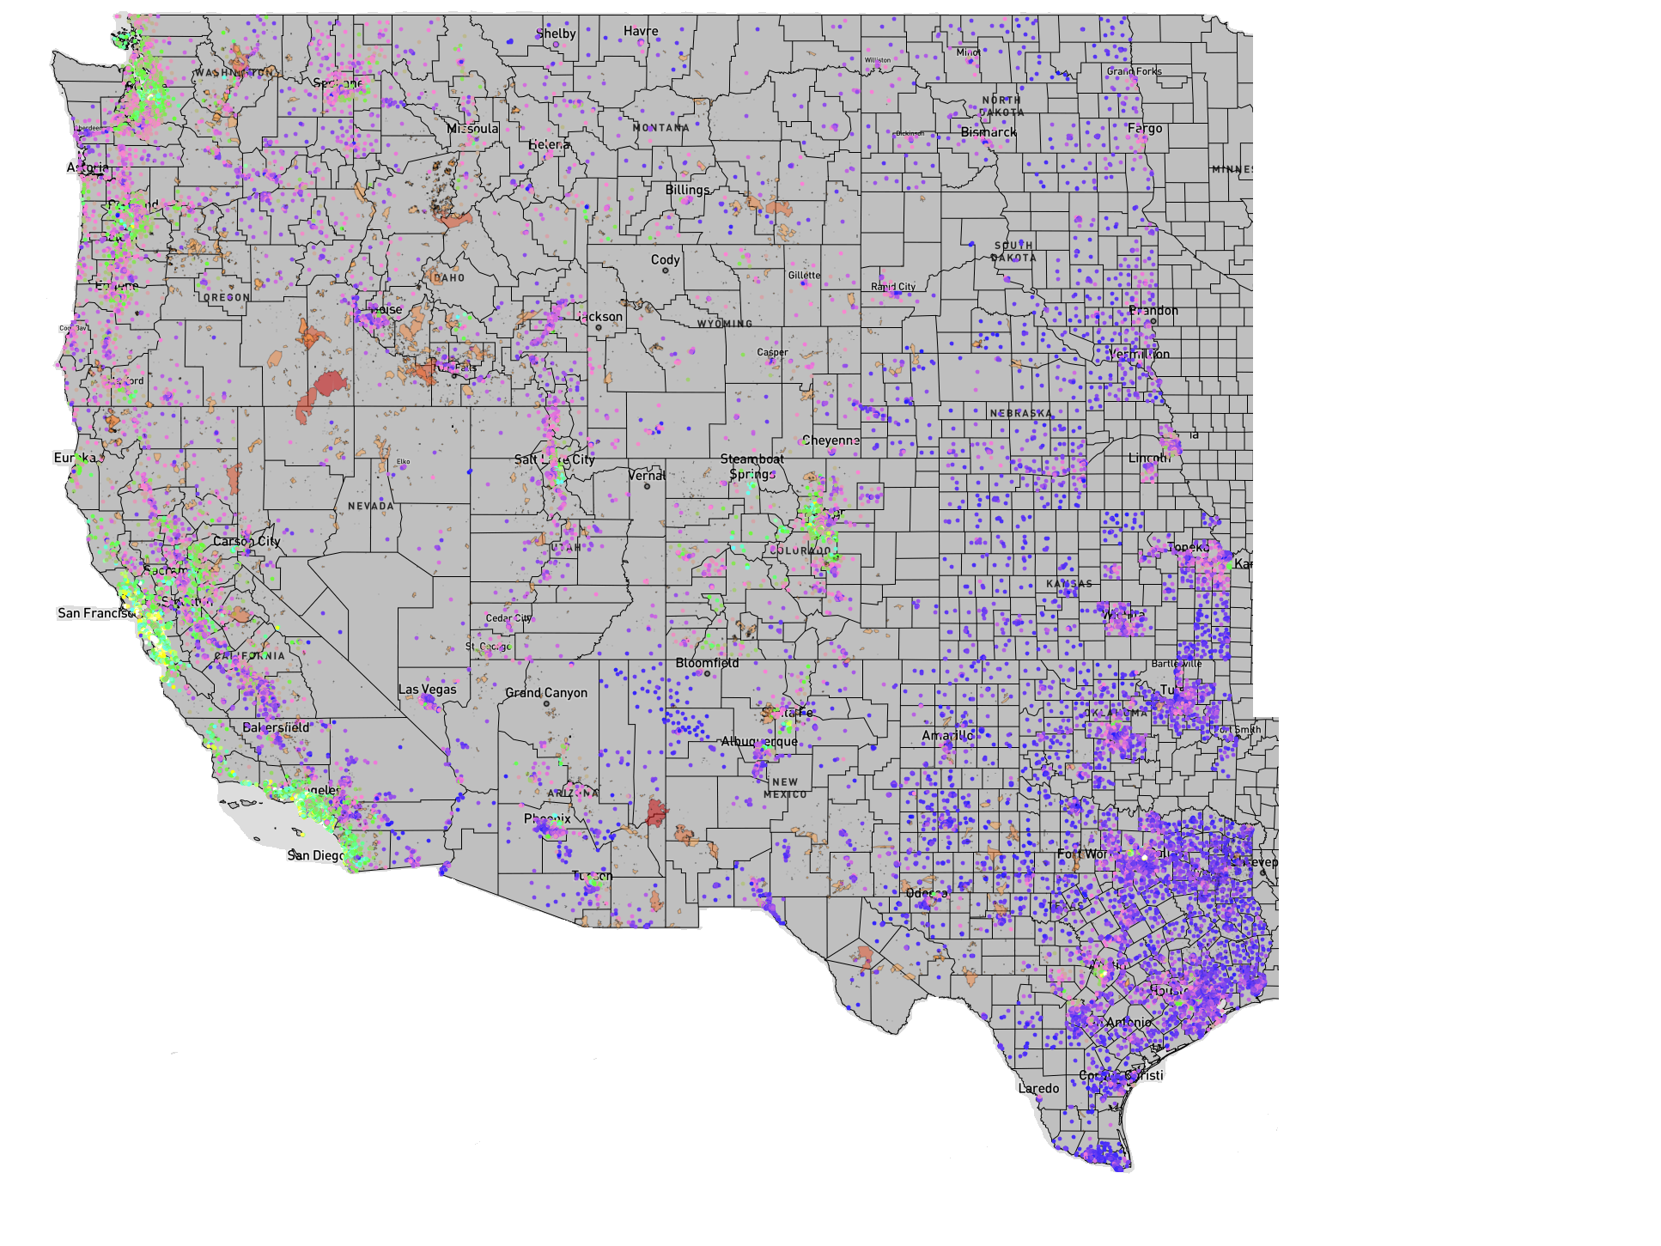
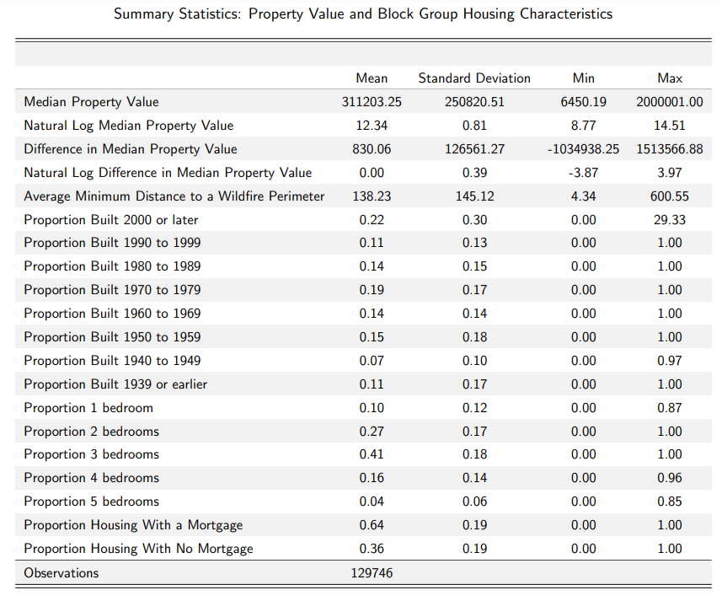
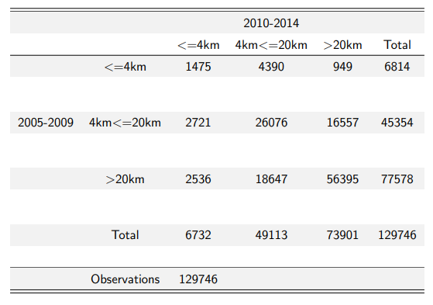
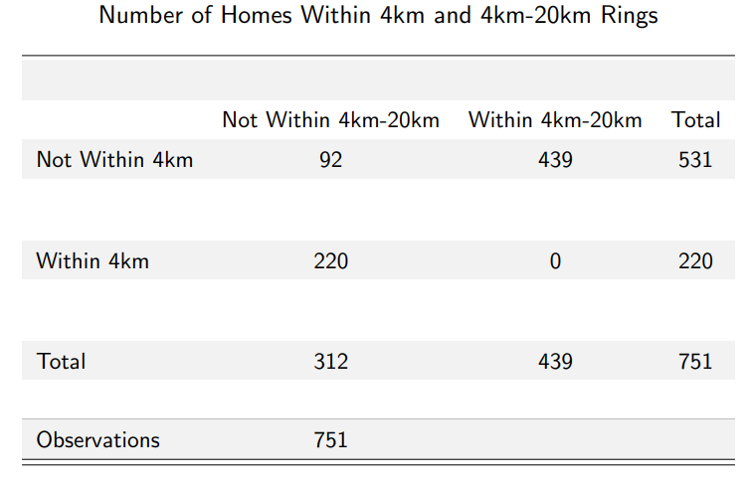
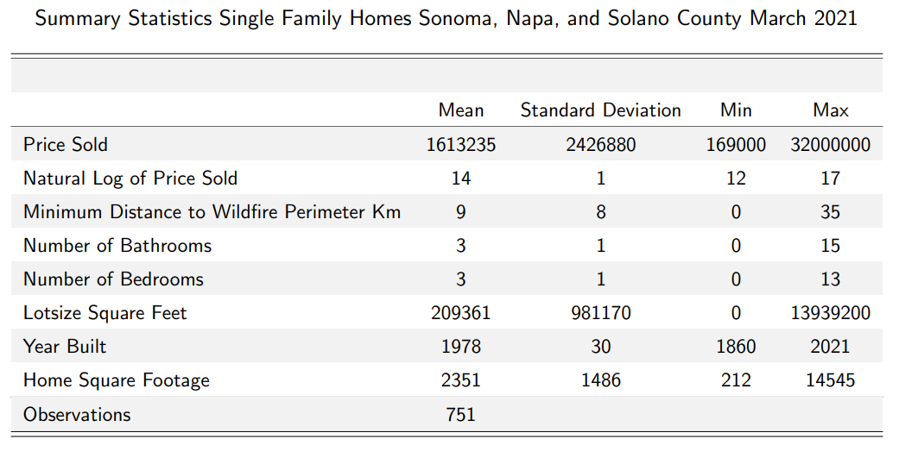
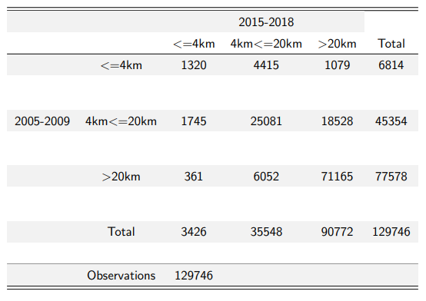
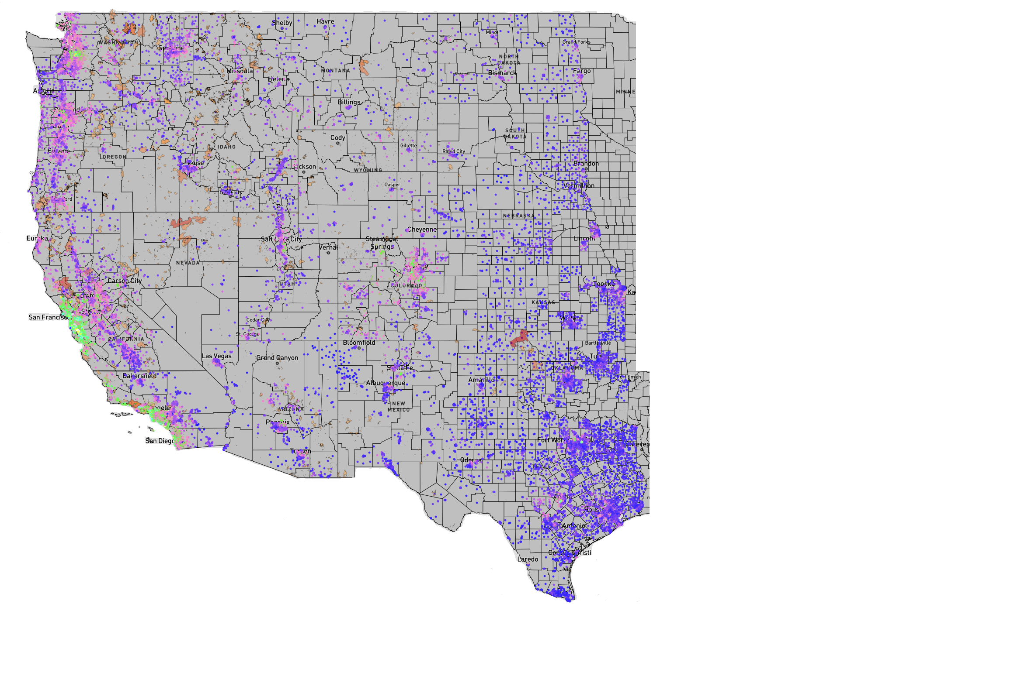
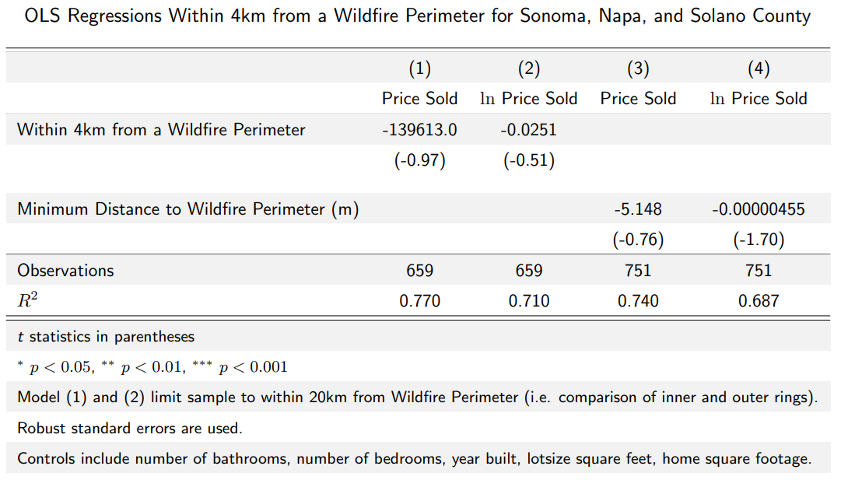
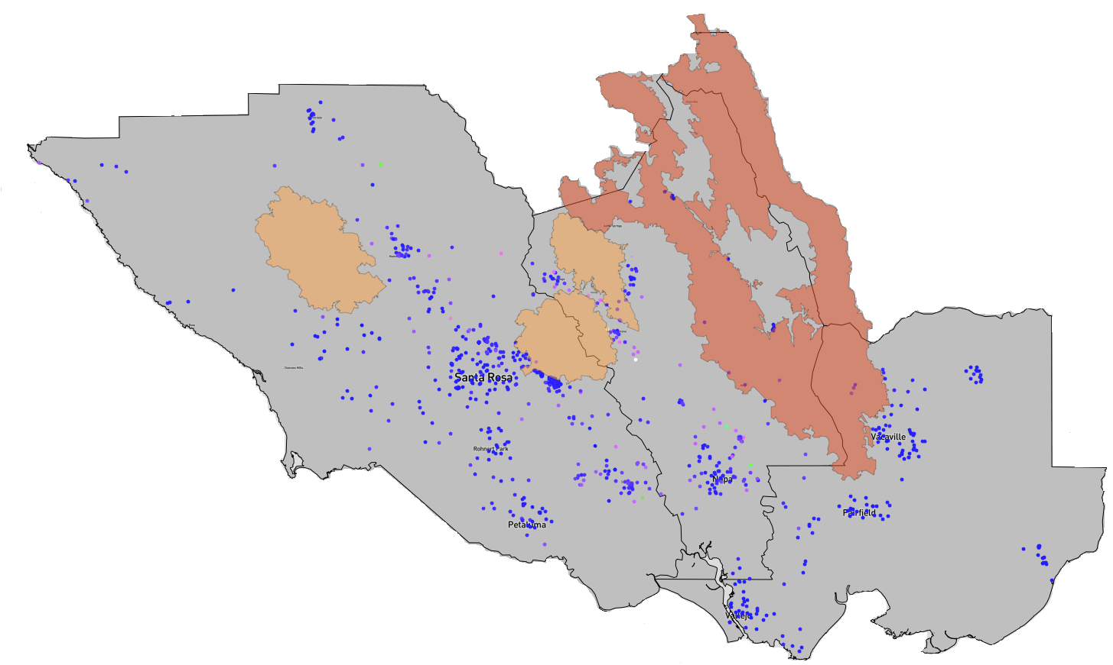
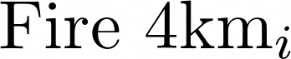
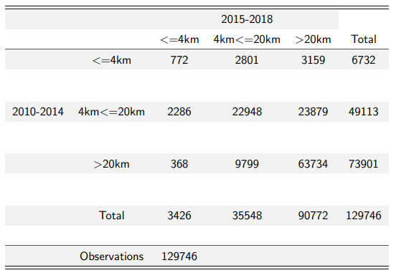
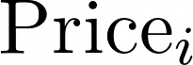
The Effect of Wildfire Proximity on Property Values
Author: Sheldon Birkett Advisors: Victor Couture & Marit Rehavi
Introduction
Research Question:
How does climate risk change peoples location preferences?
What is the effect of wildfire proximity on property values?
First Difference Estimation & Robustness
Variables:
- Median property value for a block group (i) at time (t).
- Difference in median property value at time between period (t-1) and period (t).
- Dummy variable for being within 4km from a 2015 wildfire perimeter and at least within 4km from any wildfire perimeter in the previous years (“4 km 2015 Ring” in Table below).
- Dummy variable for being within 4km from a 2015 wildfire perimeter only and not being within 4km from any previous wildfire perimeter (“4km 2015 Ring Exclusive in Table below).
- Time fixed effects for 2005-2009, 2010-2014, and 2015-2019 periods.
- Matrix of controls: contains housing characteristics and demographic characteristics.
Example of Using Haversine to Calculate the Great Circle Distance Between Two Points
The great circle distance between two points on a sphere is given by:
The graph above shows the number of wildfires in the Western United States between 2000 and 2018 has remained relatively stable, but the number of acres burned over time has become more volatile which is suggestive of increasing wildfire intensity.
Across the Western United States development in wildfire risk areas is the fastest-growing land-use type, with 97 percent of developments in wildfire risk areas the result of new housing, which has been associated with more wildfire ignitions (Radeloff et al., 2018)
Homeowners face a trade-off between the potential risk of a wildfire destroying their home, and dis-amenity effects from wildfires, versus the amenity value gained from living in areas prone to wildfires.
- Latitude of point 1 and latitude of point 2
- Longitude of point 1 and longitude of point 2
First Difference Regression Equations:
The point where the three green lines intersect is a property. Distance variable calculated by finding the great circle distance of every property (block group) to every wildfire perimeter between 2005 and 2018. For each year the distance to the closest wildfire is picked. In the map on the left this would be about 16 kilometers for that property in the given year.
Contribution
Key Findings:
Block groups located within 4km from a wildfire perimeter on average are more expensive.
There is a 7% reduction in the median property value for block groups within 4km from a wildfire perimeter in 2015 and at least one previous year in comparison to block groups further than 4km from a wildfire perimeter.
When comparing block groups within 4km from a 2015 wildfire perimeter to block groups between 4km and 20km from a wildfire perimeter there is no effect of wildfires on property values, which may suggest wildfire risk is not priced into property values under 20km from a wildfire.
With the Zillow Data for March 2021 listings in Sonoma, Napa, and Solano County California there was no effect of the autumn 2020 Glass, Hennessey, and Wallbridge wildfires on sale prices (see below for Tables).
No previous paper in the hedonic property model and wildfire risk literature has studied the effect of wildfire proximity on property values across the entire Western United States.
In 2011 California introduced a fire protection tax. However, the tax was terminated in 2017 for its inability to differentiate between wildfire risk areas.
My paper seeks to understand if people ``price-in” wildfire risk into property values. If people do price in wildfire risk into property values then it is suggestive that policies such as a wildfire tax may not be efficient at disincentivizing people from living in high wildfire risk areas.
Data Description
American Community Survey (ACS) from IPUMS NHGIS: 2005-2009, 2010-2014, and 2015-2019 five-year estimates at the block group level in Arizona, California, Colorado, Idaho, Nebraska, New Mexico, Oklahoma, Oregon, South Dakota, Texas, Kansas, Wyoming, North Dakota, Montana, Utah, Nevada, and Washington states.
Web scrape March 2021 Zillow Data on sale prices in Sonoma, Napa, and Solano counties for a robustness case study on the fall 2020 Glass, Hennessey, and Wallbridge wildfires.
IPUMS NHGIS TIGER/Line+ Shapefiles: Block group location data for 2009, 2014, and 2019 merged with IPUMS NHGIS ACS data on block group ID.
National Interagency Fire Center (NIFC) & Geospatial Multi-Agency Coordination Group (GeoMAC): “Historic Wildfire Perimeters Combined 2000-2018” shapefiles contain wildfire perimeter data for every recorded wildfire in the United States for each year between 2000 and 2018.
Wildfire Perimeter: perimeter that encloses the estimated burn area determined by the wildfire management agency.
The above graph shows the calculated average minimum distance to a wildfire perimeter and the inter-quartile range (i.e. 25th and 75th percentiles) for every year in the NIFC data frame.
Slight downward trend in the minimum distance to the wildfire perimeter suggests there are more wildfires in more populated areas, or housing development is expanding into previously rural areas.
2005-2009 Wildfires & Median Property Values
2010-2014 Wildfires & Median Property Values
The association is significantly less negative beyond 40km from a 2015 wildfire perimeter when controlling for time invariant unobserved amenity factors (e.g. distance to bodies of water)
Tabulations of Distance from Wildfire Perimeter
Sonoma, Napa & Solano County Case Study:
2015-2018 Wildfires & Median Property Values
Glass, Hennessey, and Wallbridge Wildfires November and October 2020
OLS Regression:
Maps show that the median property value has been declining in real terms with the majority of wildfires occurring in less densely populated areas across the Western United States.
Each dot (block group) in the map on average represents 586 homes.
-Dummy Variable for within 4km from one of Glass, Hennessey, or Wallbridge Wildfires
- Zillow price sold as of March 2021.
[1] Radeloff, V. C., Helmers, D. P., Kramer, H. A., Mockrin, M. H., Alexandre, P. M., Bar-Massada, A., Butsic, V.,Hawbaker, T. J., Martinuzzi, S., Syphard, A. D., and Stewart, S. I. (2018). Rapid growth of the us wildland-urbaninterface raises wildfire risk.Proceedings of the National Academy of Sciences, 115(13):3314–3319.
[2]Steven Manson, Jonathan Schroeder, David Van Riper, Tracy Kugler, and Steven Ruggles. IPUMS National Historical Geographic Information System: Version 15.0 [dataset]. Minneapolis, MN: IPUMS. 2020. http://doi.org/10.18128/D050.V15.0
[3]GeoMAC (2020). Historic perimeters combined 2000-2018.
[4]Zillow.com. (n.d.). Retrieved March 26, 2021, from https://www.zillow.com/

